Slide 1
Sentiment Analysis of Google Play App customer reviews
Capstone Project
Isaac Kar Wai Low, Data Scientist

Slide 2
Agenda
Bio
Project Context
Define
Design
Deliver
Summary, conclusions and next steps
Appendix: list of supporting documents

Slide 3
Bio
Education
Masters of Information Technology Graduate 2019, Major: Data Analytics
Professional Experience
Experience in data engineering at a start-up called Possible doing NLP
ANZ virtual internship project on GitHub
25+ features engineered, 5+ models used
Sentiment Analysis Mini Project catalyst for Capstone Project

Slide 4
Project context
Industry or domain
Application software development: Android and iOS, mobile, and web
Problem area
Young start-up Possible Me operates in a competitive landscape that adopts an Agile, customer-focussed approach. Even so, customer complaints are not being read because of its large volume and variety
However, their A/B Testing time takes an average of 3 days. Using NLP and sentiment analysis, they want to be able to quickly forecast the current sentiment concerning the product portfolio to speed up iterations

Slide 5
Define
Business aspects
Stakeholders: Customers, Manager, Product Owner, Requirements Analysts, UI/UX Designers, Web Developers, Java developers, IT Project Manager, Financial Manager, Marketing Manager, Data Engineers, Data Analysts.
Business question: How to increase delivery cycle speeds by prioritizing applications with the lowest perceived value from customers?
Stakeholder & ROI/Dollar Value:
Reduce change fail percentage for cycle times
Reduce mean time to restoration for cycle times
Goals
To increase production cycle times
To increase quarterly operational gross profit

Slide 6
Define
Data Science aspects
Data question
Question: What are the models and features give us the best accuracy and ROC scores when predicting sentiment of customer reviews on the Google Play Store?
Data required
To answer the question, we need to frame the problem as a supervised machine learning problem that requires labelled training and test data.
Customer reviews: text string type
Sentiment label: binary or polarized integer type
Data Sourced
Kaggle: https://www.kaggle.com/ashraf1997/anz-synthesised-transaction-dataset
Google Play: https://play.google.com/store

Slide 7
Define
Data Sourced (cont.)
Volume
The data is very dense but not sparse. It only has 5 features, 2 of which are completely useless for this exercise.
Variety
The dataset contains 1074 Google Play Mobile Apps with Reviews ranging from 30 -320 per app. There is relative diversity in the groupings of Apps as they are arranged alphabetically without bias toward a particular market or genre.
The sentiment labels have 3 categories, negative, neutral, and positive labelled in a set {-1, 0, 1}.

Slide 8
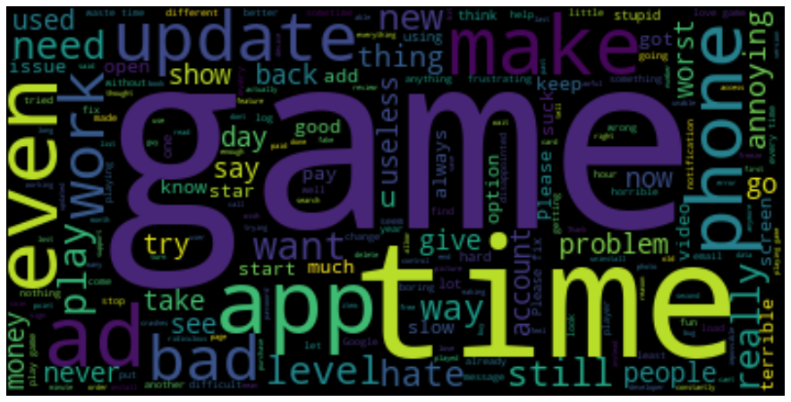
Design
Data exploration, analysis and visualisation

Slide 9
Overall process flow used

Slide 10
Deliver
Feature Engineering
Count Vectorizers (bag-of-words), Word Level TFIDF, n-gram level TFIDF, Char level TFIDF
For the purposes of sentiment analysis, Count Vectorizers will suffice since we are not interested in information retrieval.
Machine models used and evaluation metrics
Logistic Regression, SVM, SGD, Naïve Bayes, KNN, Decision Tree, Random Forest
Accuracy, ROC score

Slide 11
Deliver
How does the model fir the overall solution?
This will be used by the IT team at the start of a meeting or at the Planning phase of the SDLC.
In terms of products, the business will understand how it is to prioritize its attention to products that are not doing well commercially
In terms of features, the business can perform A/B feature testing faster as there is a faster mean time to recovery of errors (MTE)

Slide 12
Summary, conclusions and next steps
Summary
My data solution is a first step in addressing company wide problems. It starts with addressing salient needs proposed by the IT teams in terms of product and feature prioritization
Conclusions
Count Vectorizers and Linear SVC is a very good combination for predicting sentiment for new customer review data in the Google Play Store. However, other mobile platforms may still need addressing
Next steps
The data pipeline needs further consolidation in terms of API calls and app_id inputs
A better labelling system for new data should be implemented. Perhaps a webhook to translate ratings into sentiment labels

Slide 13
Appendix
References
https://www.grandviewresearch.com/industry-analysis/mobile-application-market
https://agilemanifesto.org/
https://www.investopedia.com/terms/v/valuechain.asp
https://techgeek365.com/5-software-development-concepts-to-improve-your-programming/
https://www.lexalytics.com/lexablog/sentiment-accuracy-baseline-testing
https://www.stitchdata.com/resources/what-is-data-pipeline/

